Slide 1
Low-Carbon Action Plan 2019-2024

Slide 2
Our Commitment
The University of Toronto has set a goal to achieve a 37% reduction in greenhouse gas emissions by 2030, from a 1990 level baseline.
“Climate change remains one of the world’s greatest challenges, and the University of Toronto community—our brilliant students and alumni, faculty and staff—are working hard to meet that challenge.”
- President Meric Gertler
Notes:
Begin with what we are actually talking about

Slide 3
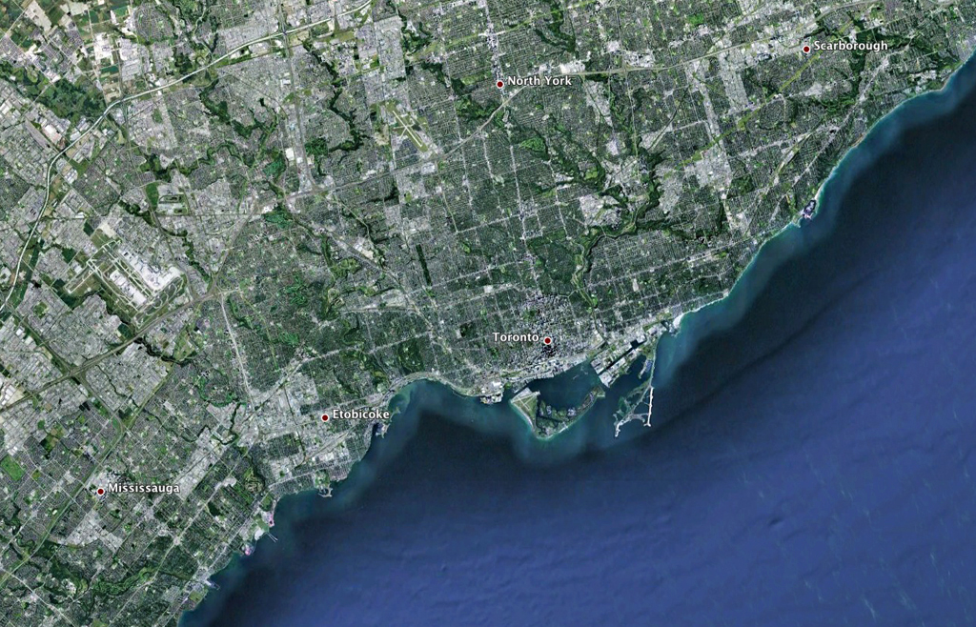
GHG Emissions by Campus
SCARBOROUGH
TORONTO
UTSC
8%
MISSISSAUGA
UTM
9%
Proportion of U of T’s GHG footprint by Campus
St. George
83%
© 2013 Google

Slide 4
Where We Are in 2019
University of Toronto:
Tri-Campus Total Scope 1 + 2 eCO₂ Emissions
eCO₂ Tonnes
GHG tonnes / GSM
200,000
180,000
160,000
140,000
120,000
100,000
80,000
60,000
40,000
20,000
0
0.200
0.180
0.160
0.140
0.120
0.100
0.080
0.060
0.040
0.020
0.000
116,959
114,265
73,684
1990
...
2000/01
2001/02
2002/03
2003/04
2004/05
2005/06
2006/07
2007/08
2008/09
2009/10
2010/11
2011/12
2012/13
2013/14
2014/15
2015/16
2016/17
2017/18
2030 Goal
Business as
Usual
Total Scope 1+2 Emissions Anticipated Growth GHG Intensity 2030 Goal 2030 GHG Intensity Goal
*This data represents all purchased utility sources including Toronto Hydro, Hydro One, Enbridge Gas, Enwave and other natural gas suppliers. Purchased utilities and GSM data include all 3 campuses, federated colleges and external entities for scope 1 & 2 emissions.
Notes:
Illustrate history of reductions, where we need to be by 2030, introduce concept of growth

Slide 5
Our Plan: How we plan to achieve our goal
We will optimize how we produce, distribute, and consume electricity and natural gas on our campuses.
PRODUCE
DISTRIBUTE
CONSUME
Clean Energy & Carbon Capture
Efficient Distribution
Reduced Consumption
Notes:
Our framework for reducing scope 1 & 2 emissions on campus

Slide 6
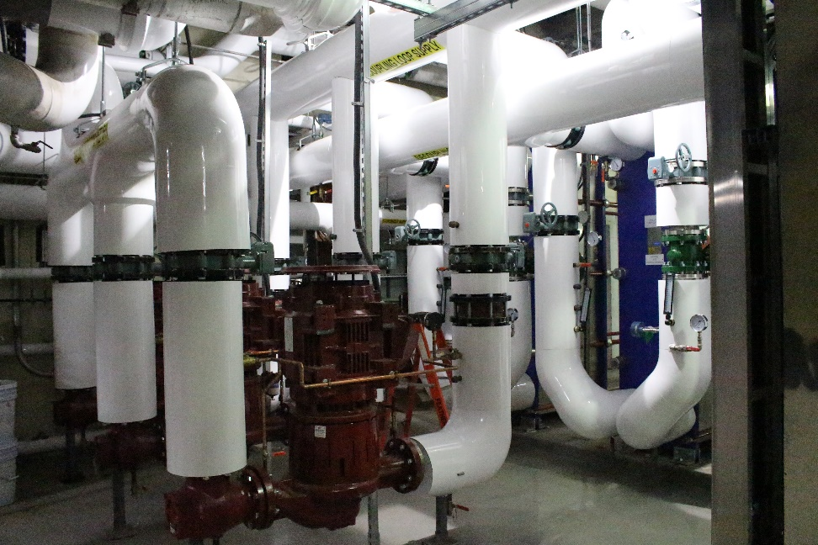
Off to a Good Start
2019 Greenhouse Gas Campus Retrofits Program (GGRP)
$50 million in investment, including support from provincial government
Completed 12 projects within 1 year:
Solar Photovoltaic & Thermal installations
High performance steam chiller & optimization
Central Plant: PRV Back pressure turbine, Sofame, cogen VSD compressors
BAS upgrades
Target GHG Reduction from GGRP=
8,600
Tonnes eCO₂/ year

Slide 7
Produce: Clean Energy & Carbon Capture
3 projects on each campus targeted to reduce emissions by over 16,000 tonnes of CO₂
Demonstrates U of T’s commitment to carbon reduction and sustainability
King’s College Circle Geoexchange represents over 25% of our total reduction target
St. George: King’s College Circle Geoexchange
UTM: New Science Building Geoexchange
UTSC: South Campus Phase II Geoexchange
Total Target GHG Reduction from Geoexchange =
16,465
Tonnes eCO2/year
Target GHG Reduction =
15,000
Tonnes eCO₂/ year
860
Tonnes eCO₂/ year
605
Tonnes eCO₂/ year
Notes:
Efforts underway across all three campuses for an increase in use of ground source heat pumps, benefits

Slide 8
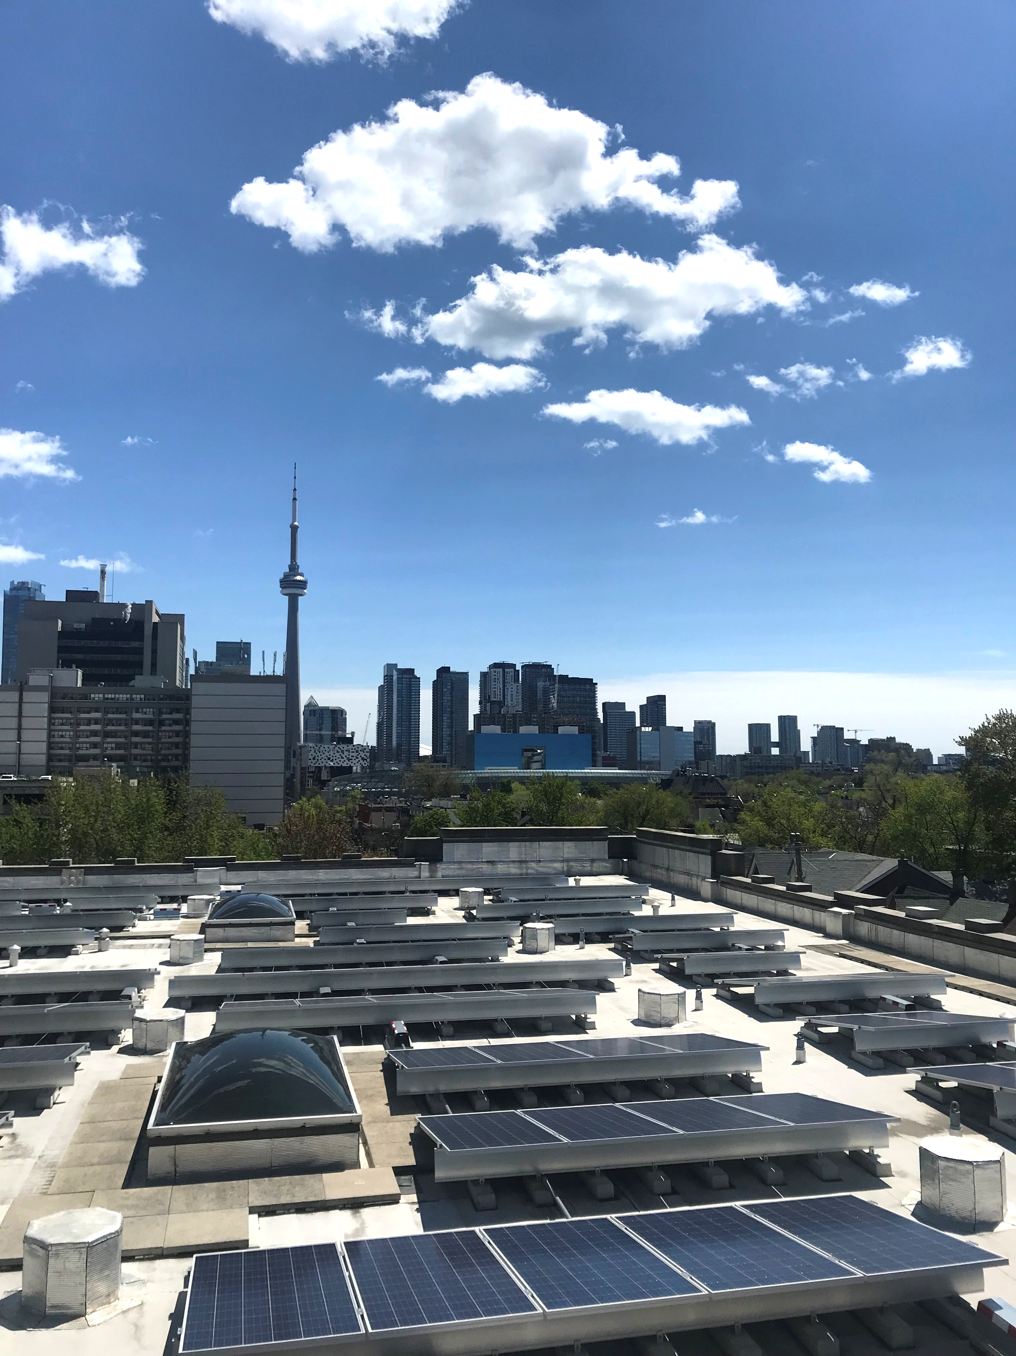
Produce: Clean Energy & Carbon Capture
Doubling Our
Renewable
Solar Energy
We will double the solar electricity from photovoltaics on our downtown campus
We will increase the use of solar energy to heat water for pools and showers
Total Target GHG Reduction
from Solar =
200
Tonnes eCO₂/ year
Notes:
Do we want to use the yellow boxes?

Slide 9
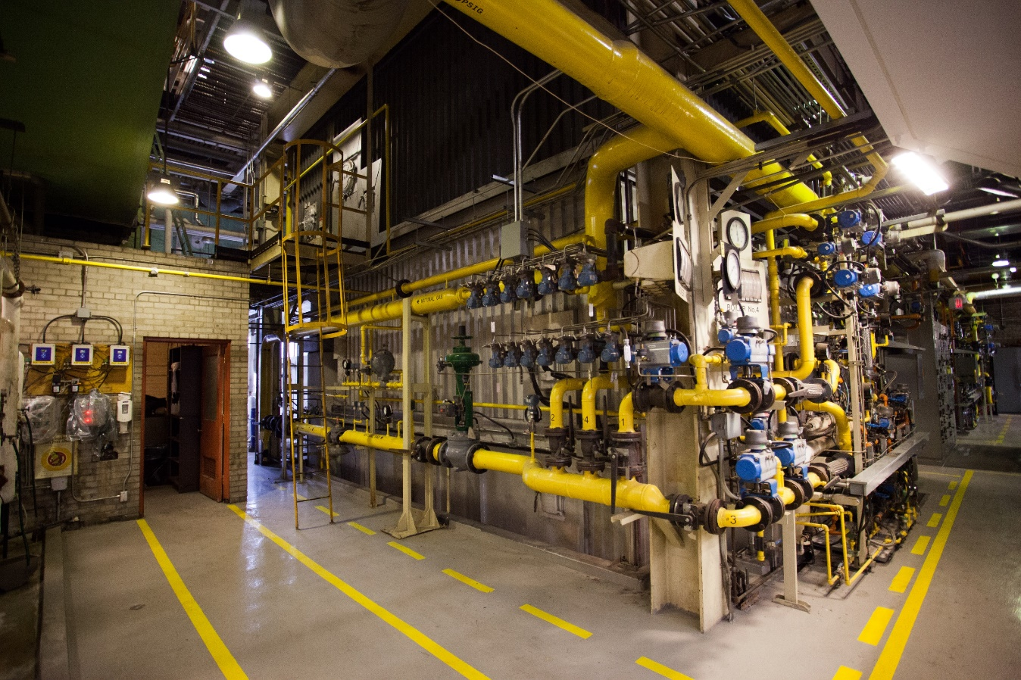
Distribute: Efficient Distribution
St. George: Central Plant Waste Heat Recovery
Increasing the Central Plant's capacity to collect excess heat in the stack for further use
This captured waste heat is considered zero incremental carbon
District Energy System Efficiencies
UTSC: South Campus Phase II Steam to Hot Water Conversion
Converting campus building heating systems from steam to hot water
Benefits: Improved delivery, controls, comfort, and reduced GHG emissions
Total Target GHG Reduction from Distribution Improvements =
2,260
Tonnes eCO₂/ year
Notes:
St. George and UTSC projects as one slide

Slide 10
Consume: Reduced Consumption
70% of our required reduction is from existing building stock
We need to invest in energy reductions at the building and system level
kg eCO₂/m²
180
160
140
120
100
080
060
040
020
000
Current Building GHG Intensity Distribution – St. George
Where we are-
69 kg eCO₂/m²/ annual average
We need to be below-
32 kg eCO₂/m²/ annual average
St. George campus buildings
Notes:
Something is off with the wording of this slide

Slide 11
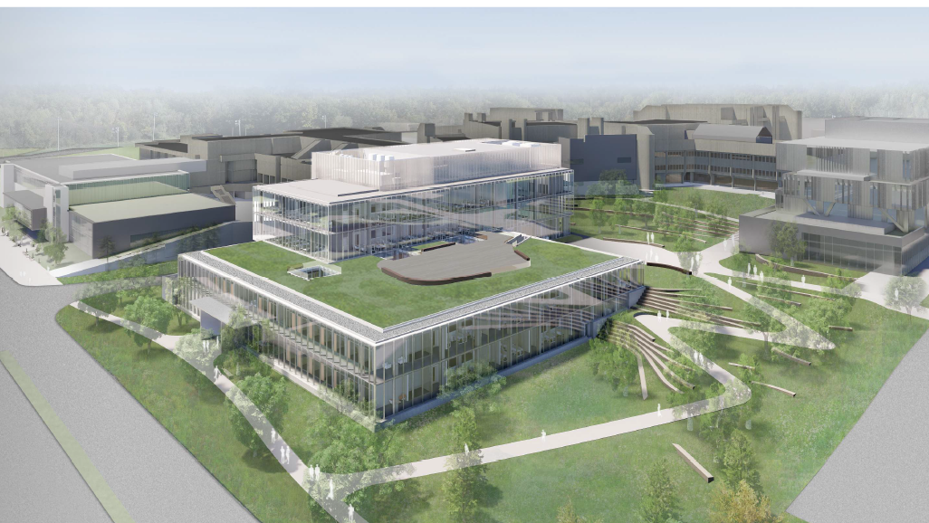
Consume: Reduced Consumption
Enhancing Building Energy Performance Design
Standards
UTM
New Science Building
The UTM Science Building will be one of the most energy-efficient biological and chemical research laboratory buildings in the world— modelled to use 65 per cent less energy than a conventional building.
New building energy performance standard for Fall 2019
The new standard will ensure advanced energy, carbon, wellbeing, and sustainability performance
Target GHG Avoidance from Designing to New Performance Standards =
8,325
Tonnes eCO₂/ year
Notes:
Profile new UTM Science building instead?

Slide 12
Consume: Reduced Consumption
Target GHG Reduction from Lighting Retrofits =
1,000
Tonnes eCO₂/ year
Replacing interior and exterior lights with far more efficient LEDs
Savings of about 40 per cent of the electricity costs, which are reinvested in more conservation projects
Wellbeing benefits: Quality lighting is an important influence on high performance work and learning

Slide 13
Pathway to 2030
University of Toronto:
Tri-Campus Planned GHG Reductions (2019-2024)
Tonnes eCO₂
/ year
Where we would be without our plan
Where we project to be with our 2019-2024 plan
Reductions to be completed 2025-2030
Business as usual
Building Design Standards
Geoexchange
Building Optimization
Lighting Retrofits
2030 Goal
Solar
Distribution Improvements
2019 GGRP Projects
Trees (Urban Properties)
Notes:
Absolute reduction with growth = 114, 265 + 18,000 (good growth) – 73,684
= 58, 581
Progress = 44,567/58,581
=

