Slide 1
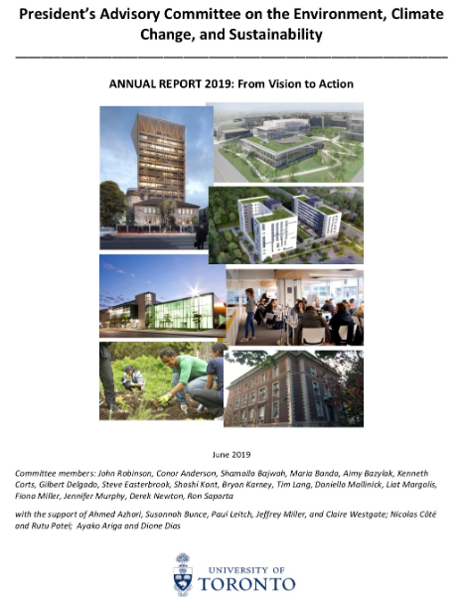
President’s Advisory Committee on the Environment, Climate Change and Sustainability
Mandate
to advance coordination of the University’s contributions and objectives pertaining to research and innovation, academic programs, and sustainability initiatives related to our operations
CECCS Annual Report, 2019

Slide 2
Committee members
Alumni Lisa DeMarco, DeMarco Allan LLP
Student Shamaila Bajwah, Undergraduate
Student Aviatar Inbar, MSc Sustainable Management, UTM
Faculty Aimy Bazylak, Mechanical Engineering
Faculty Bryan Karney, Civil Engineering
Faculty Jan Mahrt-Smith, Rotman School of Management
Faculty Shashi Kant, Forestry, UTM
Faculty Liat Margolis, Architecture, Landscape and Design
Faculty Fiona Miller, Health Policy, Management & Evaluation
Faculty Jennifer Murphy, Chemistry
Faculty James MacLellan, Physical & Env. Sciences, UTSC
Faculty Steve Easterbrook, School of the Environment
Staff Daniella Mallinick, Academic Programs Office
Staff Derek Newton, Innovations and Partnerships Office
Staff (vacant), Planning, Design and Construction
Staff Ron Saporta, Facilities and Services
4 staff
9 faculty
2 students
1 alumna

Slide 3
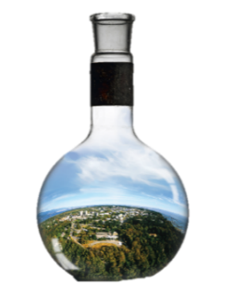
Three Subcommittees
Campus as Living Lab
University as Agent
of Change
Curriculum Innovation

Slide 4
CECCS Goals
1000 students/year on CLL projects on campus
Global leadership in sustainability standards
Signature sustainability projects
5000 students/year on AOC projects in the community
Develop sustainability-oriented CEL principles
Sustainability a priority in CEL courses
Sustainability curriculum pathways for every undergraduate student
Sustainability community of practice for faculty
Sustainability a key component of U of T identity
International leadership in operational and academic sustainability

Slide 5
New Phase for CECCS in 2019: From Vision to Action
Dec 2018, President approved:
Extension of mandate of CECCS and Presidential Advisor to end of 2020
Hiring two senior full-time staff to support CECCS
Providing 4 student RAs per terms for two years
Funds for conference attendance
This has allowed us to begin to implement our ambitious plans

Slide 6
Current CECCS Activities
CLL | CLL principles, projects, student opportunities, and database
AOC | Community of practice for CEL instructors (with CCP)
CI | Sustainability curriculum pathways programs at 5 divisions
Air Travel | Measuring air travel emissions; virtual conferences; internal offsets
UC3 / U7+ | Leadership in the UC3 and U7+ network
SDGs at U of T | SDG Advisory Group: SDG-related efforts across U of T
Sustainability Day | Sustainability Day: Innovation Prize, grants, scholarships, & showcase
Subcommittees
Projects

